Slide 1
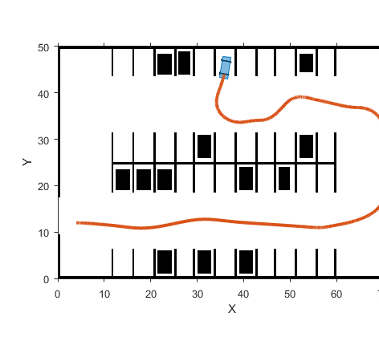
Smart Car Parking System
Team members :
Harshit Mishra 1SI20EC034
Kunal Chanda 1SI20EC042
Harish M 1SI20EC032
Chetana C Y 1SI20EC019
Tannistha Nandy 1SI20EC099

Slide 2
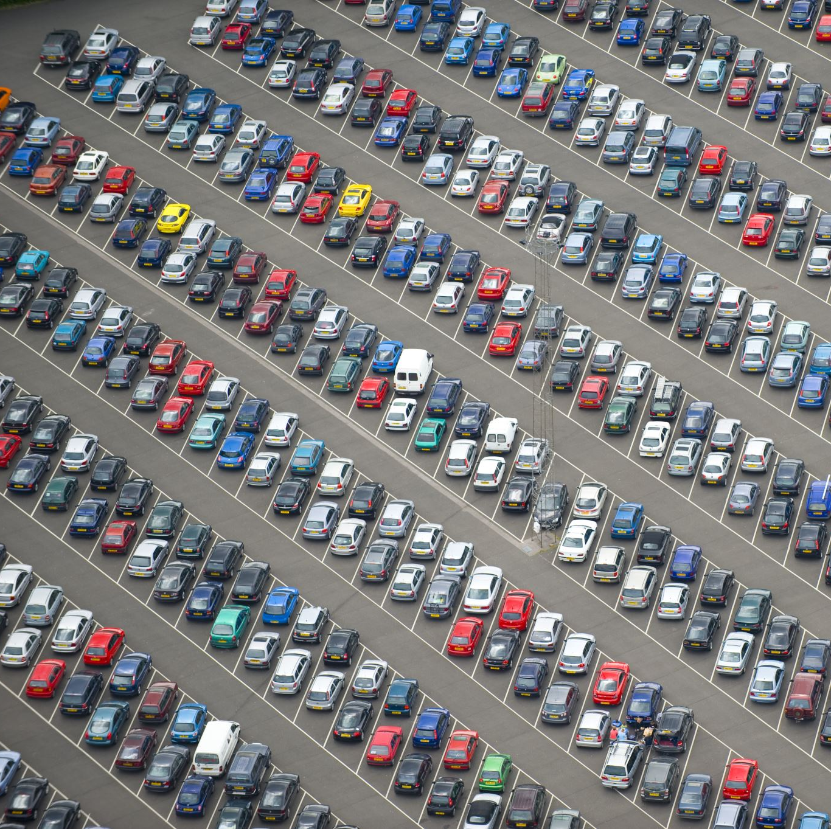
AIM
Our aim to display the number of free slots available to park the Car in parking area.
We also aim is to Assist the driver to park their vehicle in the place allotted specifically for the vehicle.

Slide 3

Overview
We are using surveillance camera to achieve the empty slots in parking area in real time
Before applying the camera to this project, we have to design a prototype which process the image and extract the info about filled and empty slots
After we have that algorithm , we can connect the camera to our project and read video frame by frame and apply our image processing to get the info .
We also can make an api to connect with web or app interface to make it easily accessible to users.

Slide 4
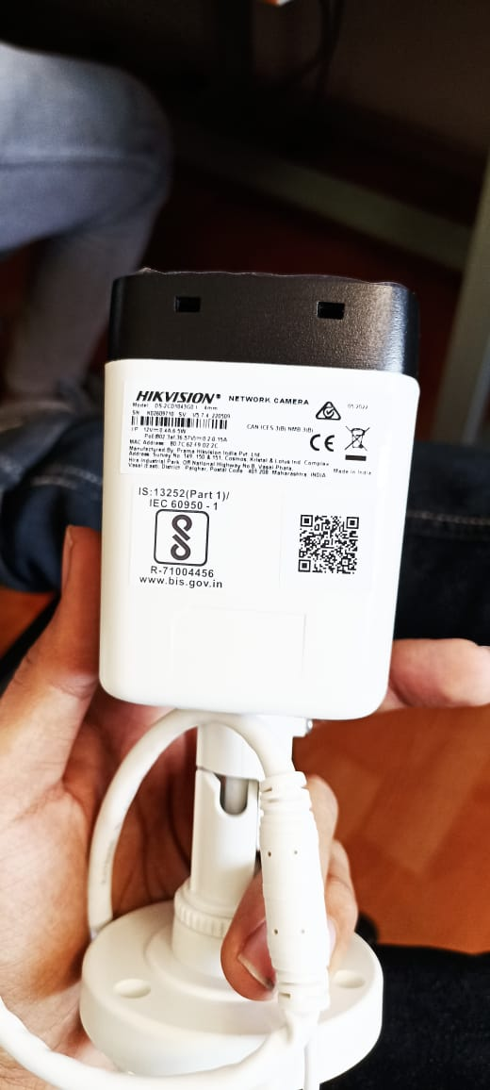
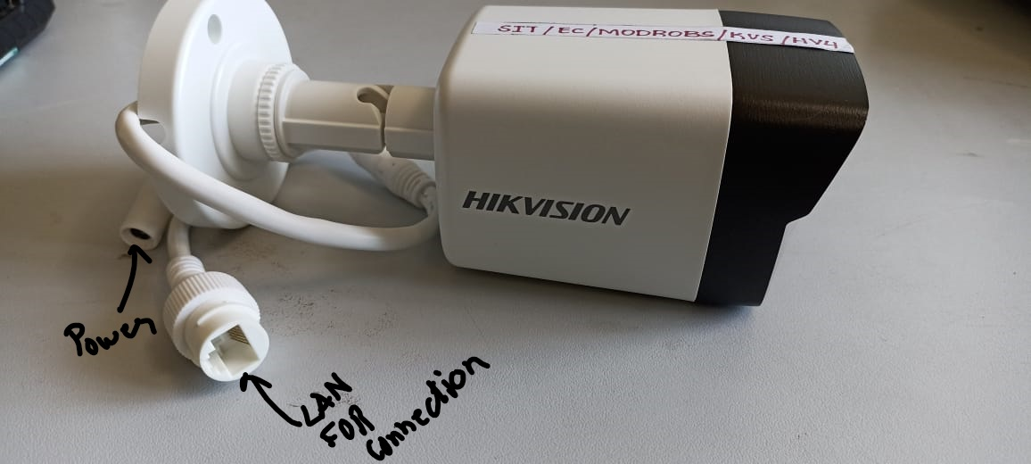
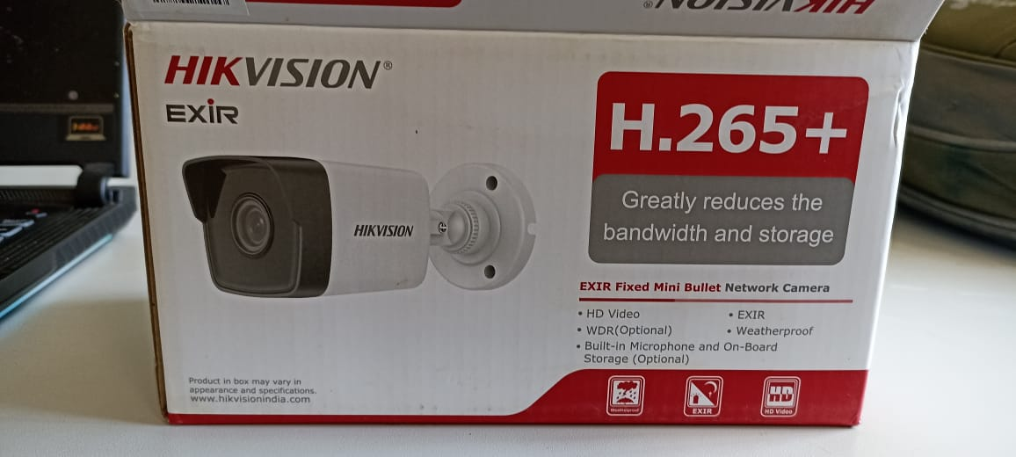
Camera - Hikvision

Slide 5
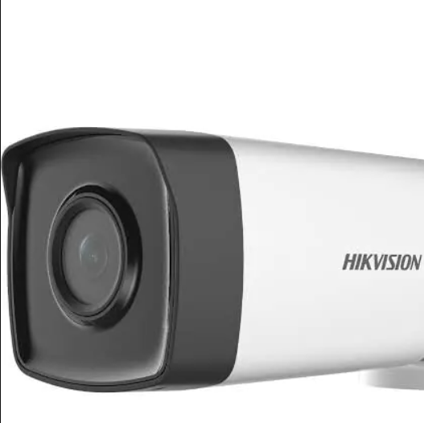
Camera Specification
High quality imaging with 4 MP resolution compatible with NVR
Efficient H.265+ compression technology
Clear imaging even with strong back lighting due to 120 dB WDR
Water and dust resistant (IP67)
EXIR 2.0: advanced infrared technology with long IR range

Slide 6
Camera Application
Application –
A surveillance camera can be used in a smart parking system for monitoring and tracking the movement of vehicles in a designated parking area.
This can aid in managing and optimizing the use of parking spaces, ensuring efficient use of the available space and reducing the time it takes for a vehicle to find an available spot.
The camera can be used to detect the presence of a vehicle in a parking space and automatically update the availability status of that space in real-time. Additionally, the camera's footage can be used for security purposes and to track any suspicious activity in the parking area.

Slide 7
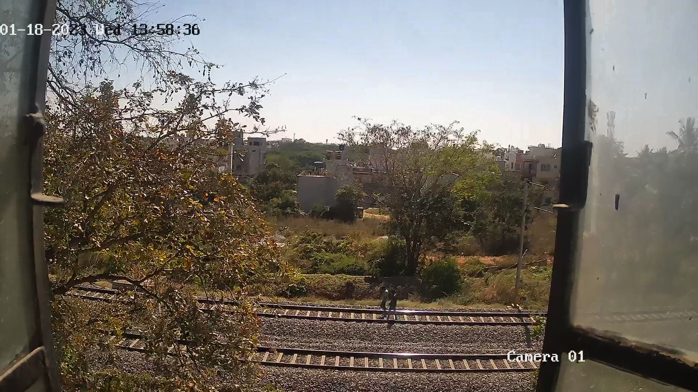
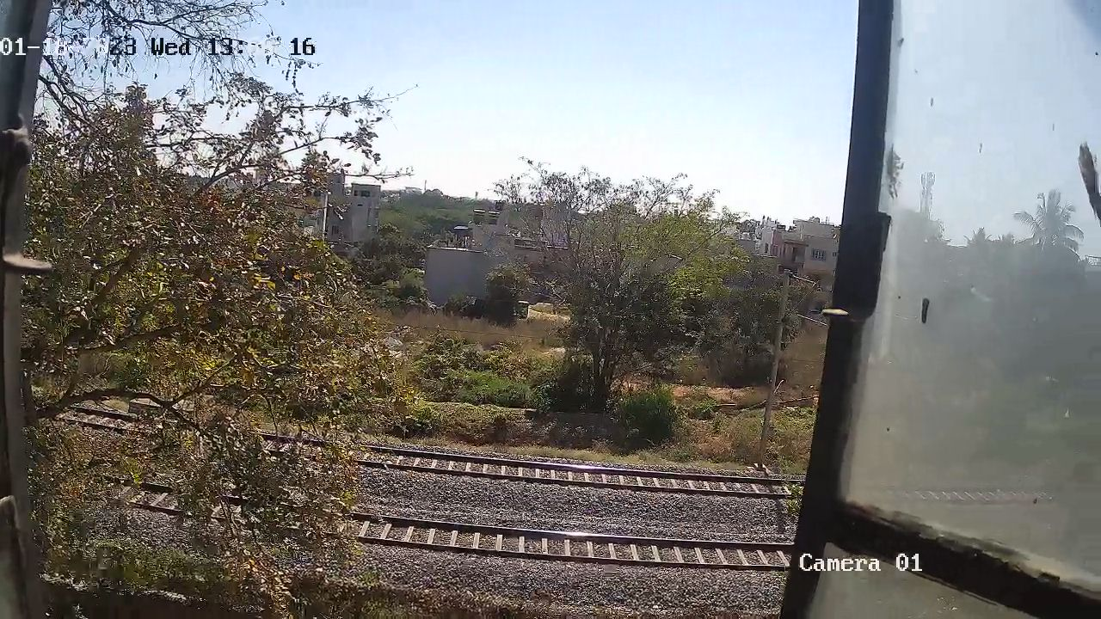
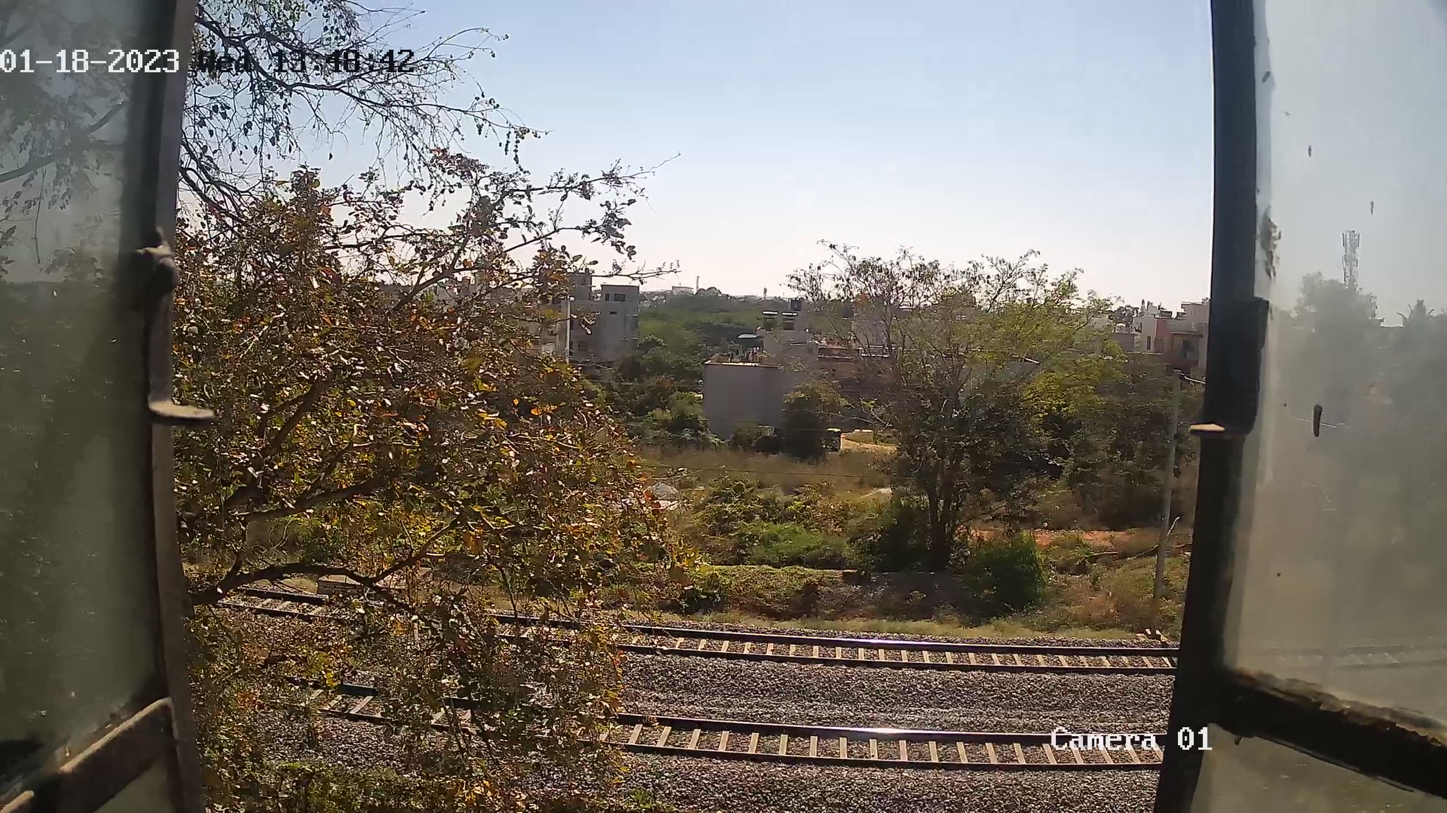
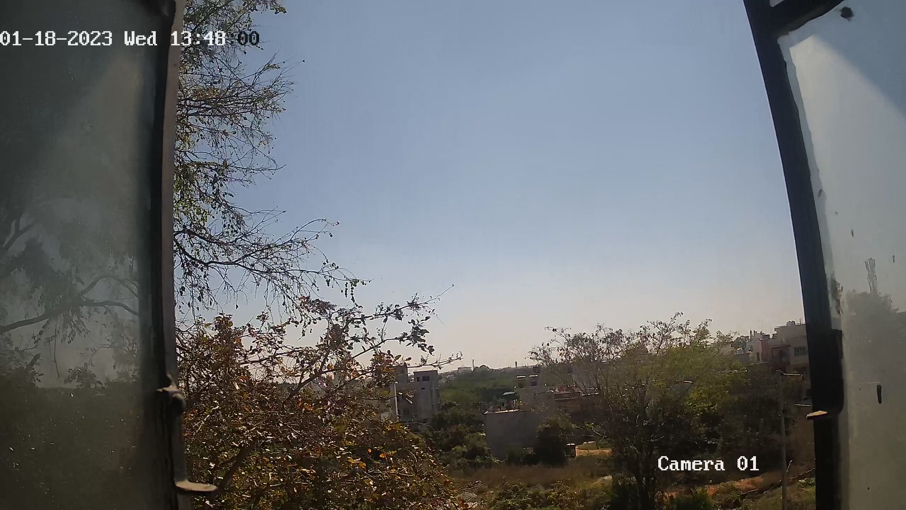
Photos Clicked from Hikvision
This camera support video quality up to 2560 x 1440.
The camera is having various type of mode to capture video ( Night vision)

Slide 8
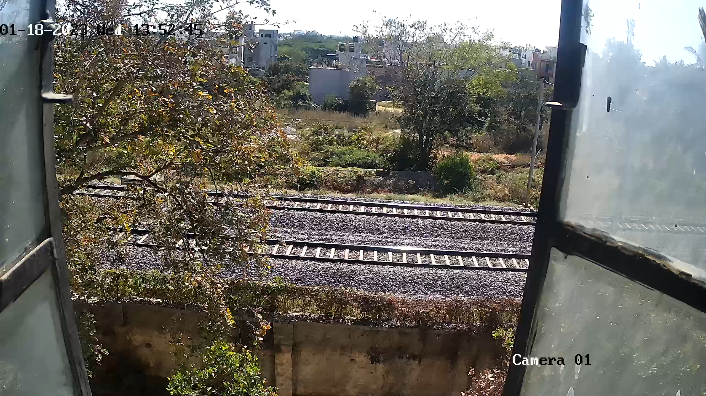
Videos

Slide 9
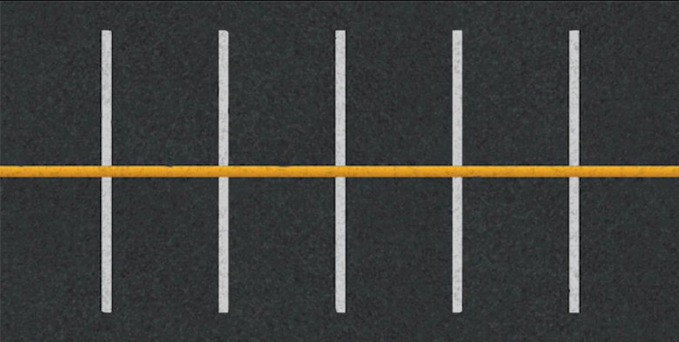
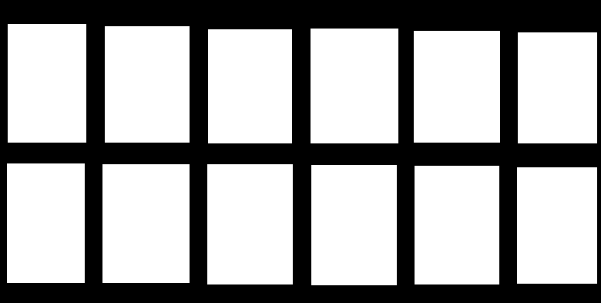
Algorithm
First, we need to a image of empty parking slot so that we make our Region Of Interest so that we will be focus only on those region for object detection
After masking the ROI we can will get the Mask image ->

Slide 10
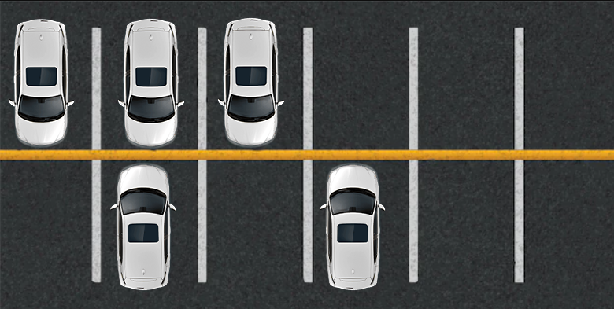
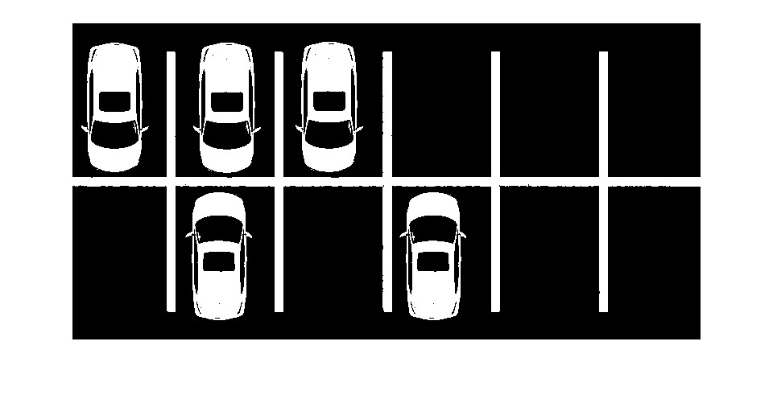
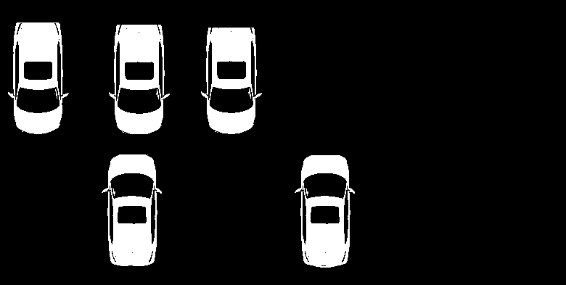
Algorithm
Now we will take the image which is having some cars parked in the parking are and convert it to a binary Image.
When we apply the mask on the binary Image then we will get only the ROI parts in the result.
After this we can set a threshold (let’s take 60% of area ) If the black is not continuous then we’ll increase out count to 1 in object detection list ;

Slide 11
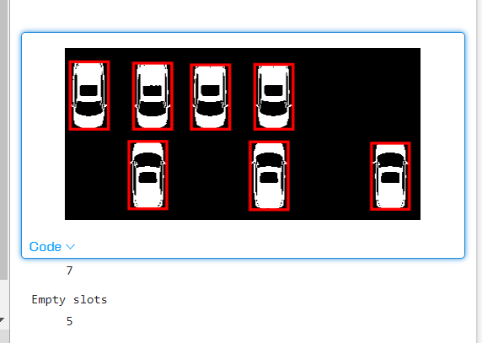
Algorithm
Now we have applied the mask and get the image in our ROI
Now we will use blob detection which is one of the object detection technique to detect the number of car parked
Now we will subtract the number of parked car from total strength of parking area to get the number of free slots as we can see in 3rd image.

Slide 12

Thank You

